Slide 1
NETFLIX
DATA ANALYSIS
BY SAHIL

Slide 2
Netflix History
Netflix was founded in 1997 by Reed Hastings and Marc Randolph in California as a DVD rental-by-mail service. The idea was to make movie rentals more convenient and customer-friendly compared to traditional video rental stores.
In 2007, Netflix introduced its online streaming service, which allowed users to instantly watch movies and TV shows. This marked a major turning point in its business model.
By 2013, Netflix began producing its own original content, starting with the critically acclaimed series House of Cards. Over the years, it has grown into one of the world’s leading entertainment platforms, known for global hits like Stranger Things, The Crown, and Squid Game. Today, Netflix has over 250 million subscribers across more than 190 countries, transforming how the world consumes entertainment.

Slide 3
OBJECTIVE
The objective of this Exploratory Data Analysis (EDA) project is to deeply examine Netflix’s content catalog to uncover meaningful patterns and trends.
By analyzing various attributes such as content type, genre, release year, country distribution, and creator involvement, the goal is to gain insights into Netflix's content strategy and audience preferences, and identify areas for future content opportunities.
By identifying trends in content type, regional focus, production timelines, and popular genres, the analysis can help understand Netflix’s expansion strategy, content diversity, and market focus — providing a data-driven view of its competitive positioning in the streaming industry.

Slide 4
PREPROCESSING DATA STEPS
1. Importing Necessary Libraries.
2.Loading and Reading the Netflix Data File.
3. No of rows and columns in the Data.
4. Columns Overview.
5.Data Cleaning (Handling Null Values)
6.Checking Datatypes and Changing Datatypes.
7.Drop Duplicate Rows.
8.Understanding data :
Using info() and describe() for statistical summary

Slide 5
Dataset Overview
1.There are 8790 Rows and 10 columns.
2.There are no null values and duplicate rows.
3.Converted date_added column from object to date_time.
3.1 Converted type and rating column from object to category.

Slide 6
Columns Overview :
Column Name | Description
1. show_id | Unique identifier for each show
2.type | Whether the content is a Movie or a TV Show
3.title | Name/title of the show
4.director | Name of the show's director
5.country | Country where the show was produced
6.date_added | Date when the show was added to Netflix
7.release_year | Year when the show was originally released
8.Rating | Netflix content rating (e.g., TV-MA, PG-13)
9.duration | Length of the show (minutes for movies or seasons for TV shows)
10.listed_in | Genres or categories the show belongs to

Slide 7
Exploratory Data Analysis
BY SAHIL

Slide 8
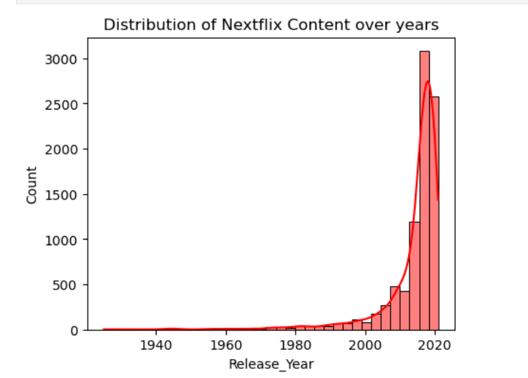
1.Distribution of Netflix content over the years:
Insight:
Rise After 1990:
There was a significant increase in the number of films released after 1990, likely due to the rapid growth and booming phase of the global film industry during that period.
Drop After 2019:
A sudden decline in film releases is observed after 2019, primarily due to the global COVID-19 pandemic, which disrupted production and distribution across the industry.

Slide 9
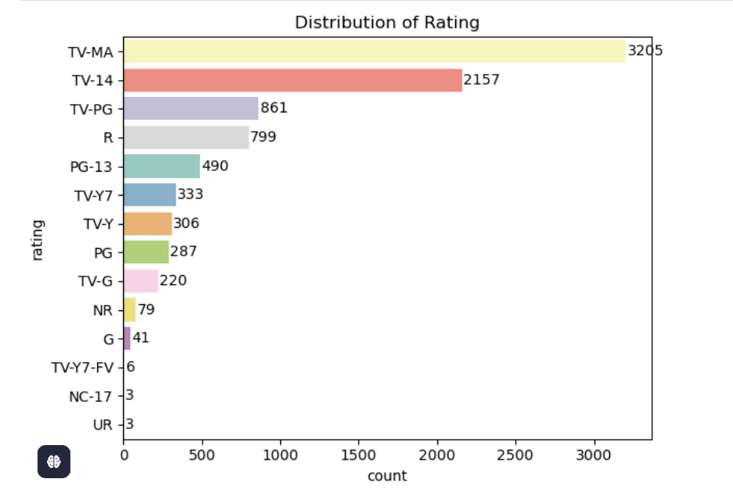
2. Distribution of Rating:
Insight:
The content ratings are ranked based on the number of occurrences, from highest to lowest:
1.TV-MA – Most common rating with the highest count.
2.TV-14 – Second most frequent rating.
3.TV-PG – Third most common rating.

Slide 10
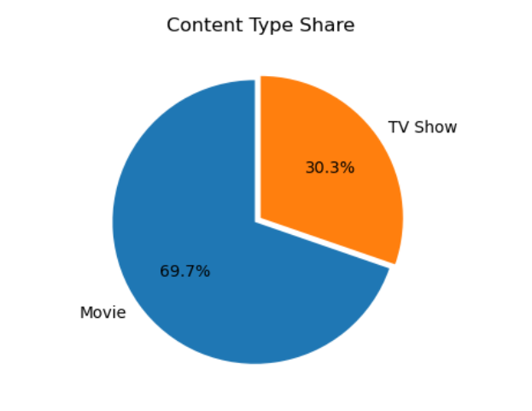
3. Distribution of Types:
Insight:
Movie Preference Dominates:
A majority of people (69.7%) prefer watching movies over TV shows (30.3%).
-- People prefer movies over TV shows because movies are shorter, offering a complete story in one sitting. –
-- They often have higher production quality and feel like special events.
-- Movies are easier to watch without long commitments, while TV shows require following many episodes.

Slide 11
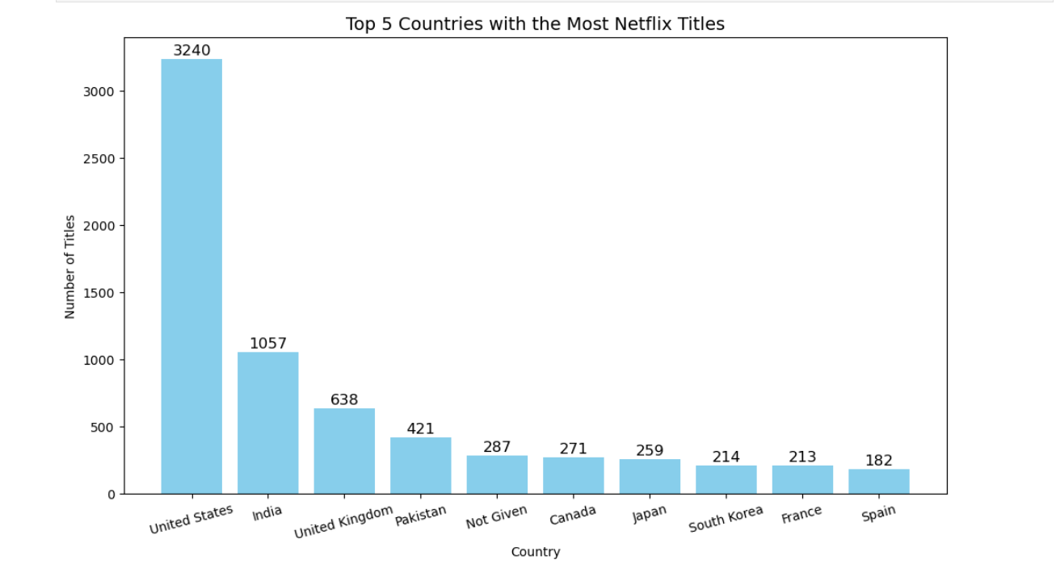
4.Top 10 Countries with highest number of Netflix titles:
# INSIGHT:
# The United States has the highest number of titles at 3,240, significantly more than the other countries.
# India follows with 1,057 titles, then the United Kingdom with 638, Pakistan with 421, and countries like Canada, Japan, South Korea, France, and Spain.
1 .The United States has the highest number of Netflix titles because Netflix is based there, the U.S. has the world’s largest film and TV industry,
2 .A large English-speaking audience, and high content demand.
3.Many Netflix Originals are also produced in the U.S., boosting its content count.

Slide 12
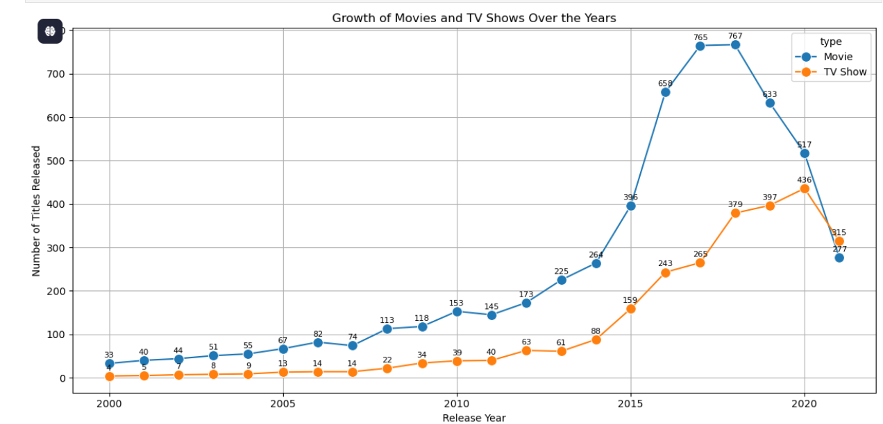
5 Analyze the growth of Movies and TV Shows over the years.

Slide 13
INSIGHT:
Why Are TV Shows Increasing on Netflix After 2018?
1.Viewer Engagement:
TV shows encourage binge-watching and keep viewers coming back.
Multiple episodes = more screen time.
Viewers build emotional bonds with characters and stories.
2.Strategy Shift:
Netflix now focuses more on original series.
Hit shows can run for many seasons.
Originals like Stranger Things boost Netflix’s global identity.
3.Licensing Changes:
Other platforms (like Disney+ & HBO Max) took back their movie rights.
Netflix has fewer licensed movies now.
So, they invest more in making their own shows.
Insight Summary:
Movies (Blue Line):
Gradual rise till 2015, peak around 2017, then slower but steady growth.
TV Shows (Orange Line):
Lower in count initially, sharp rise from 2015, peaking in 2020.
Overall Trend (Post-2000):
Both movies and TV shows increased in number, but movies consistently outnumber TV shows.
Key Point (2018–2020):
  Movies: Sharp decline in releases.
  TV Shows: Gradual increase in releases.

Slide 14
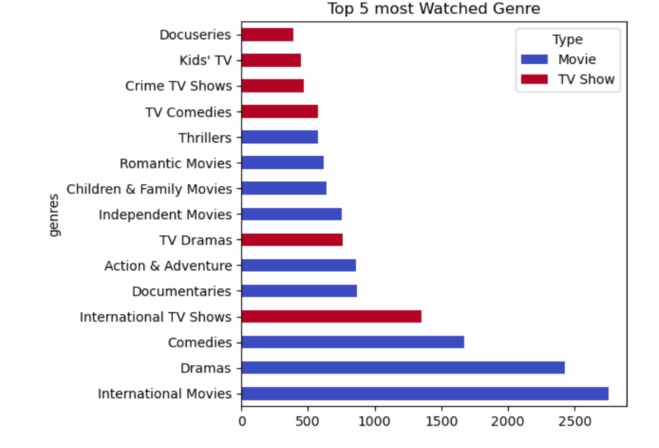
6.Most Watched Genre
INSIGHT:
1. For movies:
1.International movies is the most watched Genre among all in Type movie followed by Dramas and Comedies.
2.For Tv Shows:
.International Tv Shows is the most watched Genre among all in Type Tv shows followed by Tv Dramas and Tv Comedies

Slide 15
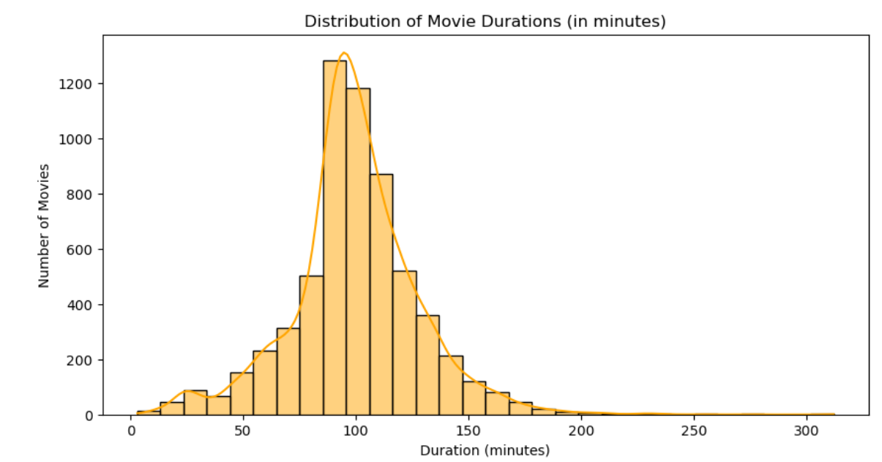
7.Distribution of Duration of Movies
Insights:
1.There are more than 1476 movies whose duration is between 90 to 100 min.
2.There are 3 movies with the shortest duration 1 minute:
3.There is only 1 movie with the highest duration 312 minutes:
-- Movie with the highest duration is Black Mirror: Bandersnatch whose duration is 312 minutes.

Slide 16
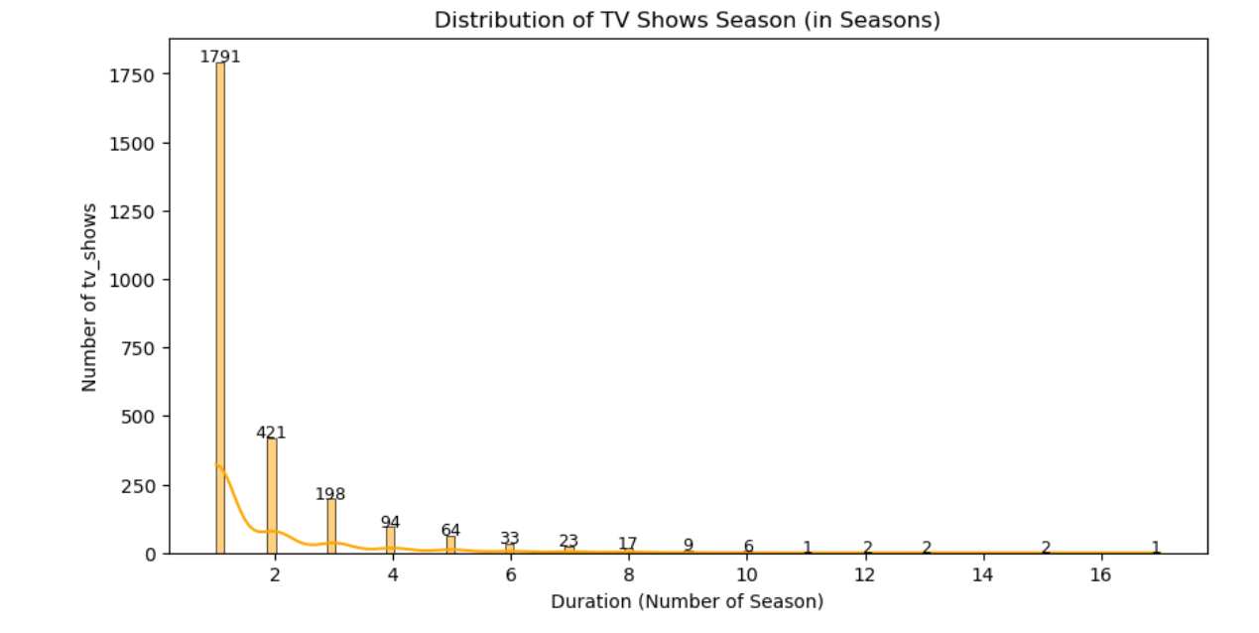
8.Distribution of Duration of Tv Shows(in seasons)
Insights:
1.There are highest(1793 tv shows) with 1 season:
2.There is only 1 Tv show( Grey's Anatomy) with 17 season:

Slide 17
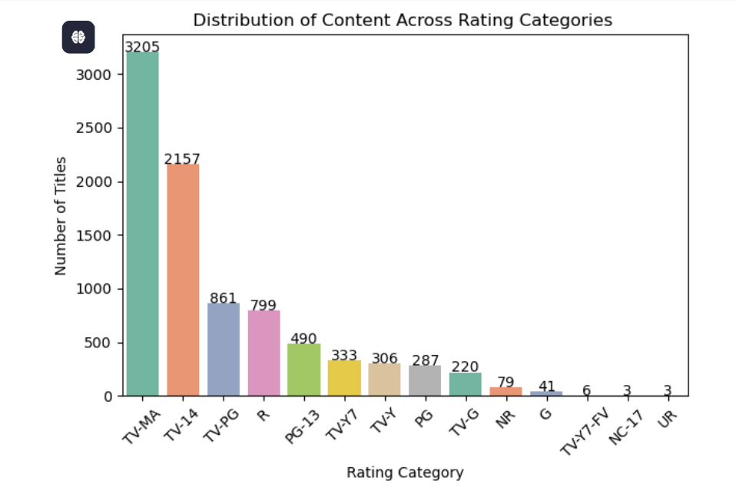
9. Distribution of content across different category:
Insight:
1.The category with the highest number of titles is "TV-MA" with 3,205 titles.
2.Other notable categories include "TV-14" (2,157 titles) and "R" (861 titles).

Slide 18
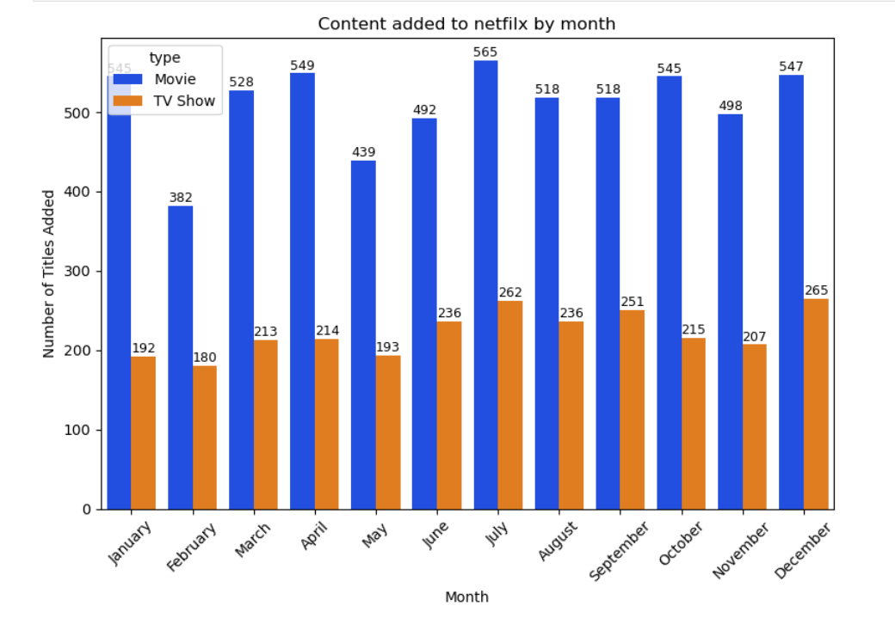
10.Distribution of Netflix Content over Month:
Movies:
July has the highest number of movies added – a total of 565 movies
Followed by April and December
February has the lowest number of movies added – only 382 movies
TV Shows:
December sees the highest number of TV shows added – 265 in total
Followed by July and September
February again has the lowest number of TV shows added

Slide 19
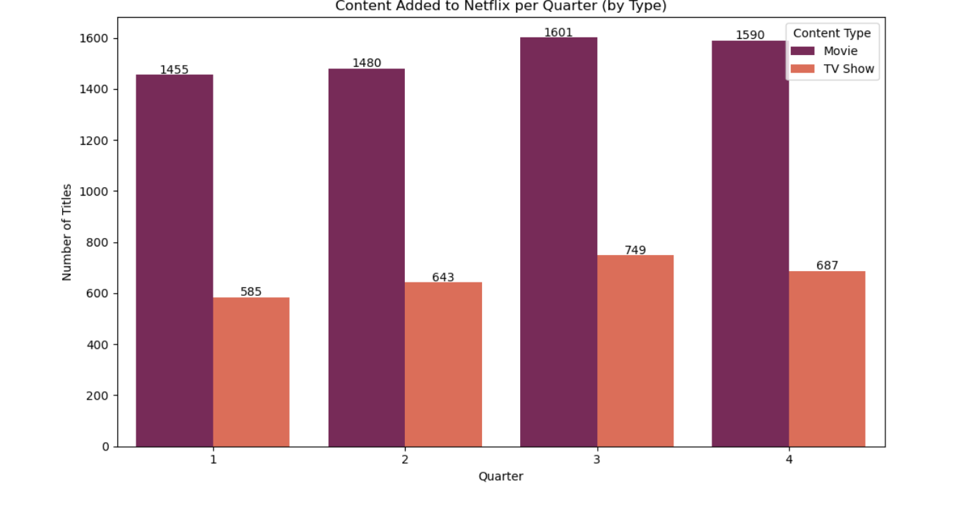
11. Distribution of Netflix content over quarter
Insight:
1 .Highest number of content was released in 3rd quarter:
Movies = 1601 titles
Tv Shows = 749
2.Lowest content was released in 1st quarter:
1 .Movies = 1455 titles
2 .Tv Shows = 585

Slide 20
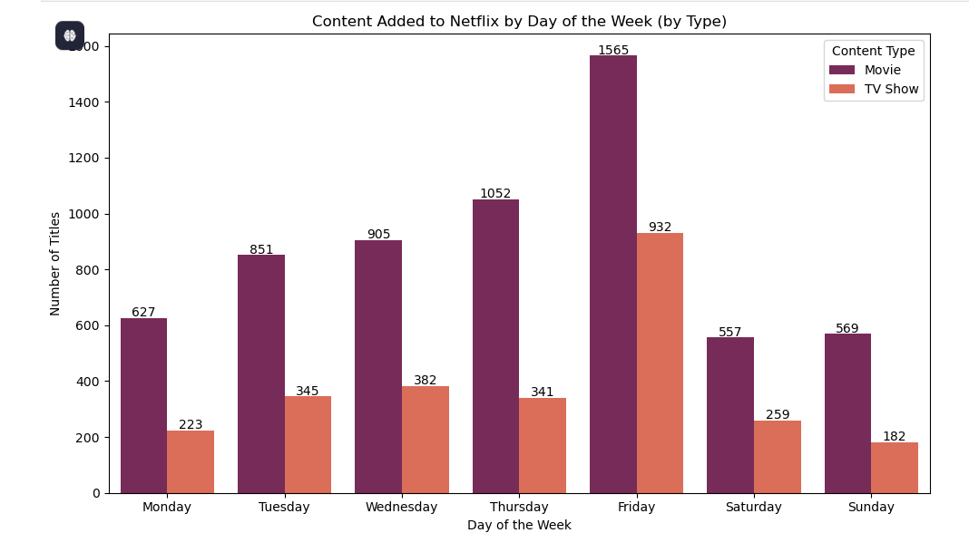
12 . Distribution of Netflix Content over weeks
Insight:
The highest number of content added to Netflix is on Friday ( for both movies(1565) and tv show(932))
The lowest number of content added to Netflix for ( movie on Saturday(557) and (for tv show on Sunday(182).

Slide 21
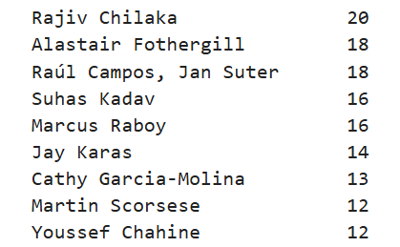
13. Most frequent directors on the Netflix platform
Most frequent director for TV Shows: Alastair Fothergill (14 TV Shows)
INSIGHT:
Most frequent director for Movies:
Rajiv Chilaka (19 Movies)
Most frequent director for TV Shows:
Alastair Fothergill (14 TV Shows)

Slide 22
14.Difference Year:
It tell how much time does the title took to release on Netflix before it was released in theatre:
Insight:
The Tv Shows Pioneers: First Women Filmmakers which originates from Pakistan took the longest time (93 Year) to Stream ON Netflix:
Insight:
1.Jake Taylor a Tv Show which was first stream on Netflix took 3 years to release in Theatre:
2.Snnse 8 a Tv Show which was first stream on Netflix took 2 years to release in Theatre:
There are total 3239 titles whose release year and streamed year on Netflix is same

Slide 23
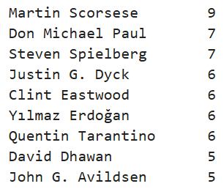
15.Directors Who worked in Most Genre:
Insight:
-- Martin Scorsese is the director who has worked in the highest number of Genre:

Slide 24
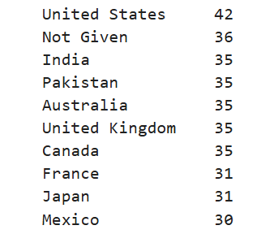
16. Top 10 country with the most diverse genre on Netflix
Insight:
1 . United State has the highest number of genre on Netflix:
2.India , Pakistan , Australia , United Kingdom and Canada has the 2nd highest number of genre on Netflix.
3.France and Japan has the 3rd highest number of genre on Netflix

Slide 25
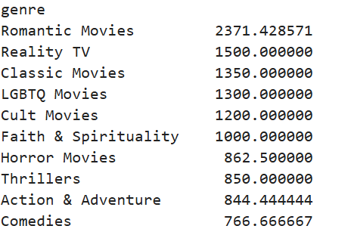
17.Fastest growing genre between 2016 to 2020 ( recent years).
Insight:
The fastest growing genre in the recent year between 2016 to 2020 is Romantic Movies followed by Reality TV and Reality Movies
Why Romantic Movies Are Growing on Netflix
1.Universally relatable and emotionally engaging
2.Boosted by hit Netflix originals (e.g., To All the Boys...)
3.Low budget, high return content
4.Increased demand during pandemic for feel-good stories
5.Popular among young audiences and global viewers
6.Netflix’s data-driven focus on trending genres

Slide 26
Conclusion
Content Boom Post-2015: Massive title growth aligns with Netflix’s global expansion.
Movies > TV Shows (but rising): TV show volume has steadily increased to meet binge-watching demand.
Global Push: While the U.S. leads in content, contributions from India, UK, and South Korea are growing fast.
Popular Genres: Dramas, Comedies, and International titles dominate due to wide audience appeal.
Adult-Focused Content: Most content is aimed at mature and teen viewers (TV-MA, TV-14).
Binge-Worthy Format: Short, limited-season shows are on the rise, boosting engagement.

